Slide 1


K.RAMAKRISHNAN COLLEGE OF TECHNOLOGY
(AUTONOMOUS), TRICHY.
EVENT SCHEDULING SYSTEM
PRESENTED BY
NIVEDHA R
2303811710422109
SUPERVISOR
Mrs. K. Valli Priyadharshini, M.E., (PhD),
AP/CSE.

Slide 2
PRESENTATION OVERVIEW
Objective
Project Introduction
Problem Statement
Methodologies (Programming concepts relevant to problem statement)
Architecture of the proposed system
List of Modules
Merits
Results and Discussion
Queries

Slide 3
OBJECTIVE
The objective of this Event Scheduling System is to simplify the process of event creation, management, and registration for both organizers and attendees. It allows organizers to create events with details such as title, date, location, and capacity, while providing real-time updates on registration status. Attendees can easily browse and register for available events, with the system ensuring that event capacities are respected. The application aims to provide a user-friendly interface for both organizers and attendees, promoting an efficient and seamless event management experience.

Slide 4
PROJECT INTRODUCTION
The Event Scheduling System is a software application designed to streamline the process of event creation, management, and registration. The system allows event organizers to create events by specifying details such as the event title, date, time, location, description, and capacity. It then enables users (attendees) to register for these events, with the system managing the available spots and ensuring no overbooking. The application provides an intuitive user interface, allowing organizers to manage multiple events and display relevant event information, while attendees can easily browse, select, and register for events.

Slide 5
PROBLEM STATEMENT
The problem being addressed is the difficulty in managing events and registrations efficiently. Organizers often struggle with scheduling, tracking available spots, and handling overbookings. At the same time, attendees need an easy way to view and register for events. This system aims to automate and streamline event creation, management, and registration, providing an efficient solution for both organizers and attendees.

Slide 6
METHODOLOGIES
The methodology behind the event scheduling system is based on object-oriented principles, where key components like users, events, and organizers are represented by classes. It utilizes Java's AWT library to create a graphical user interface (GUI), allowing users to interact with the system to create events and register for them. The system includes validation features to ensure proper data entry, manage event capacities, and provide a seamless experience for both organizers and attendees.

Slide 7
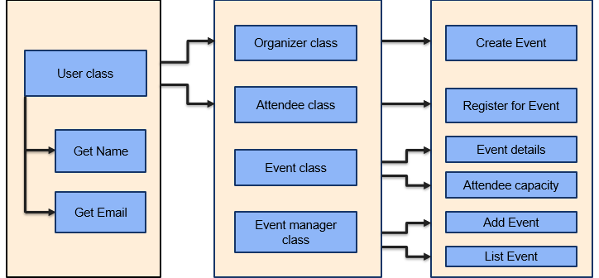
ARCHITECTURE OF THE PROPOSED SYSTEM

Slide 8
LIST OF MODULES
User Module: The User Module enables users to register for events, view event details, and manage their registrations. It allows attendees to select events, input personal information, and track available spots for events.
Event Module: The Event Module allows organizers to create, manage, and display events. It includes features to specify event details, set capacity, track registrations, and ensure that users can register without overbooking.
Event Manager Module: The Event Manager Module handles the creation, storage, and management of events. It allows organizers to add events, track registrations, manage event details, and ensure seamless event scheduling and attendee participation.

Slide 9
LIST OF MODULES
GUI Module: The GUI Module provides an interactive interface for users and organizers, enabling event creation, registration, and viewing. It includes input fields, buttons, and displays for seamless interaction with the event scheduling system.
Organizer Module: The Organizer Module allows event organizers to create and manage events, set event details like date, time, location, and capacity, and view event registrations, ensuring efficient planning and coordination.
Attendee Module: The Attendee Module allows users to register for events, view event details, check availability, and manage their registrations, ensuring a smooth process for selecting and attending events without conflicts.

Slide 10
MERITS
User-Friendly Interface: The use of a graphical user interface (GUI) ensures ease of interaction for both organizers and attendees.
Efficient Event Management: The Event Manager module efficiently handles event creation, registration, and tracking.
Capacity Management: The system prevents overbooking by tracking available spots and limiting registrations.
Data Validation: The inclusion of date and registration validations ensures accurate event scheduling and registration.

Slide 11
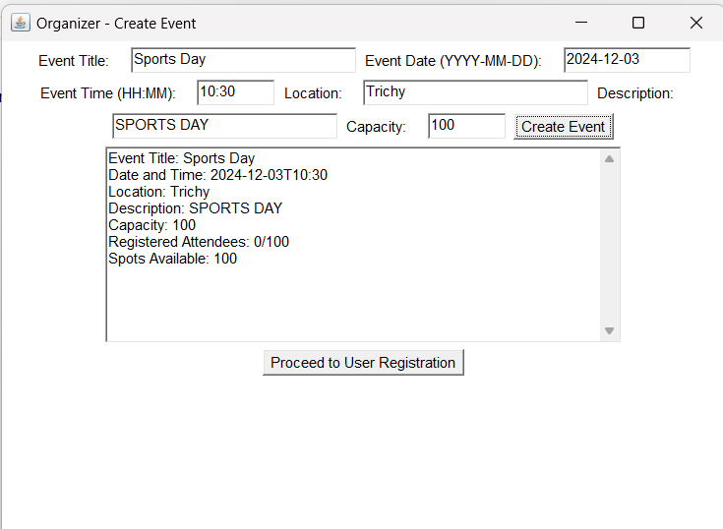
RESULTS AND DISCUSSION

Slide 12
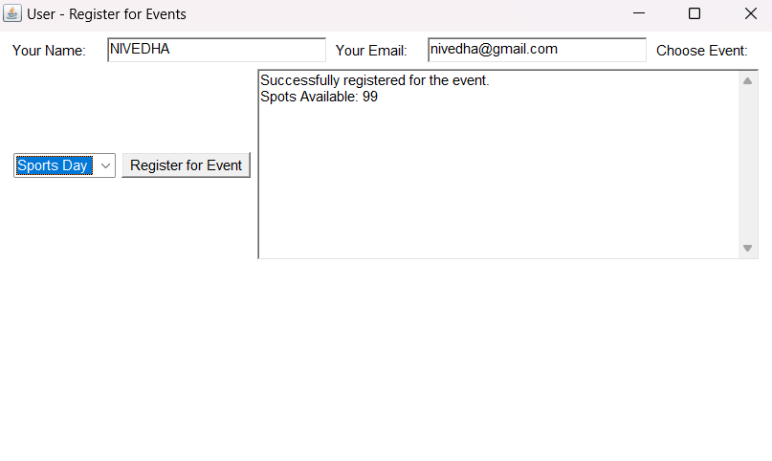
RESULTS AND DISCUSSION

Slide 13
THANK YOU

